Slide 1
Dining In The Dark:
How uncertainty inﬂuences food acceptance in the absence of light
Brian Wansinka , Mitsuru Shimizua, Armand V. Cardello, and Alan O. Wright

Slide 2
Hypothesis
Whether people are less likely to accept, evaluate favorably, and/or consume foods served in dark environments.

Slide 3
Outcome
Absence of light decreases acceptance levels if it’s an ambiguous product. If it’s a product we consume already or are at least familiar with we’re unlikely to be effected by light in a negative context.

Slide 4
Validity
It would seem fairly obvious that if you’re unfamiliar with a food and given it in a dark environment you have less trust and less willingness to consume it. The opposite is true, we’re all familiar with Lays Chips so we’ll consume it at the same level, if not more, when in the dark.

Slide 5
Implications
Redesigned packaging that has more contrasting colors can increase consumption in a dark(er) environment.

Slide 6
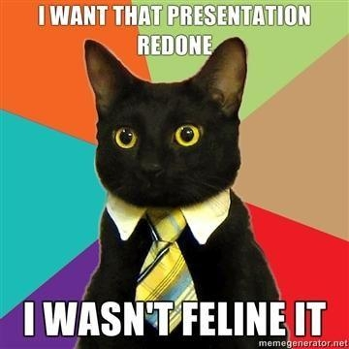
Conclusion

